Slide 1

Echo Maker Studio

Slide 2
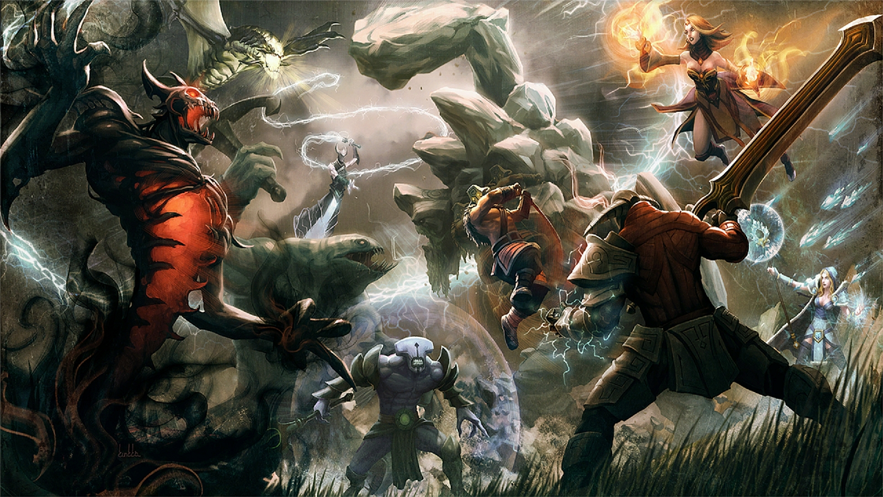
Loading…
You’re all set! Logging in…
Cleaning the maps…
Contacting the Realm…
Waking Heroes Up…

Slide 3





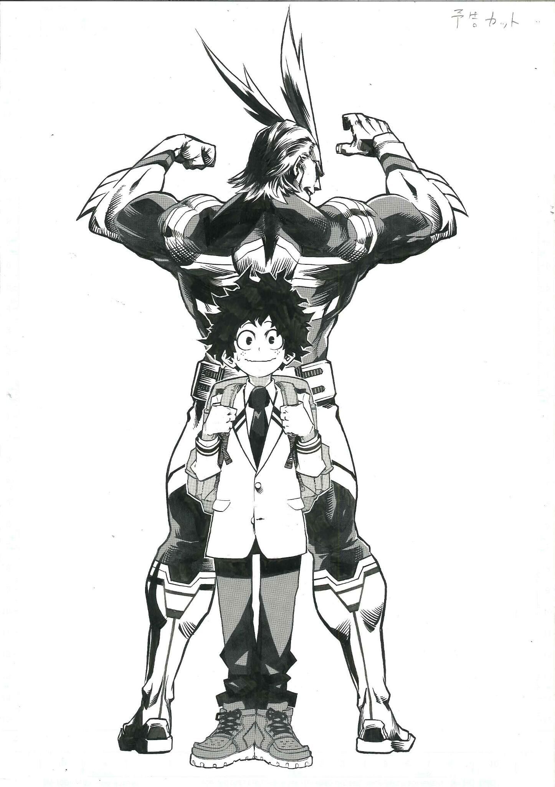
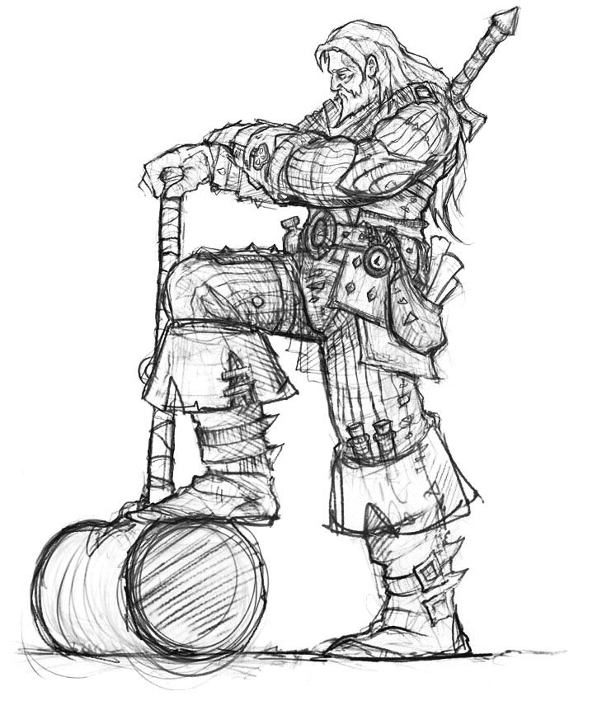
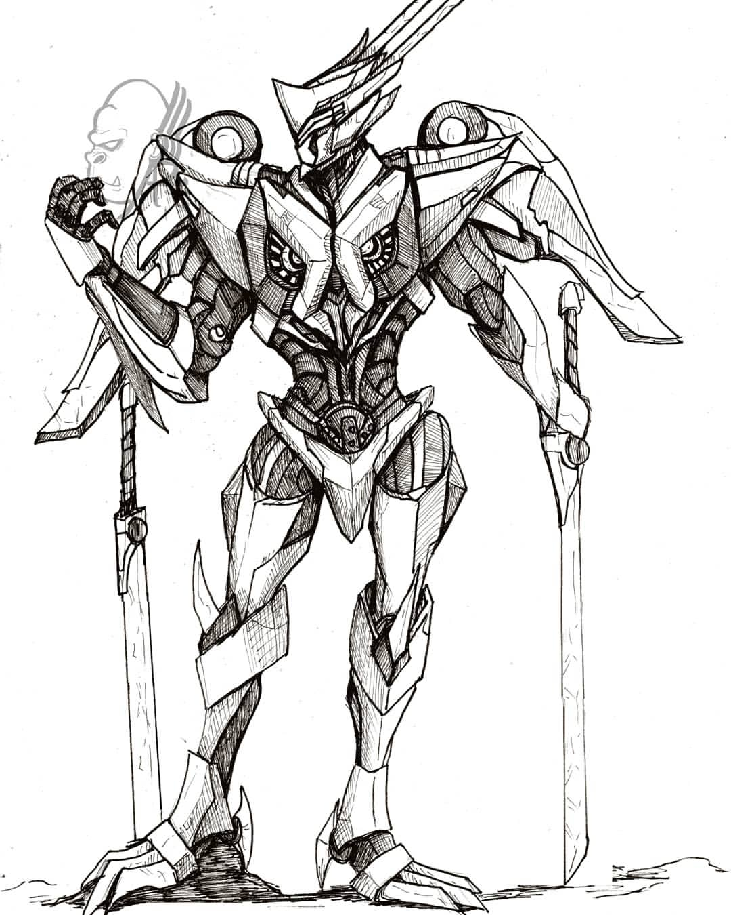








Player Name
Level 21
24.775 Mel / 300 Crystal
Friends
Legion
Quests
Hero List
Achievements
Play Game
Shop
Settings

Slide 4
Player Name
Level 21
24.775 Mel / 300 Crystal
Friends
Are you sure you want to quit the game?
Legion
Yes
No
Quests
Hero List
Achievements
Play Game
Shop
Settings

Slide 5
Finding Match…
00.00
Player Name
Level 21
24.775 Mel / 300 Crystal
Friends
Legion
Quests
Hero List
Achievements
Play Game
Shop
Settings

Slide 6
Player Name
Level 21
24.775 Mel / 300 Crystal
Friends
Game Ready
Legion
Accept
Quests
Hero List
Achievements
Play Game
Shop
Settings

Slide 7

Most Used Heroes
Statistics
Total Games : 170
Wins : 84
Losses : 86
In-game duration : 33h 41m
Heroes Own : 11 / 36
Kills : 200
Deaths : 88
Assists : 124
Statistics
History

Slide 8
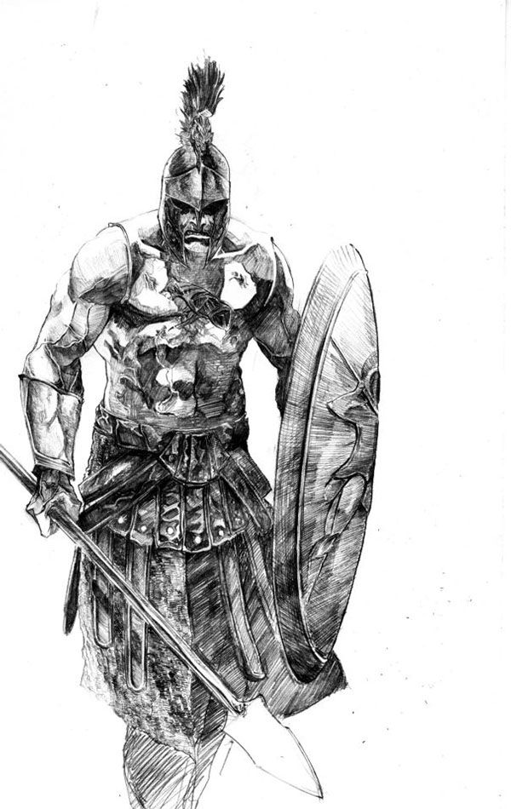
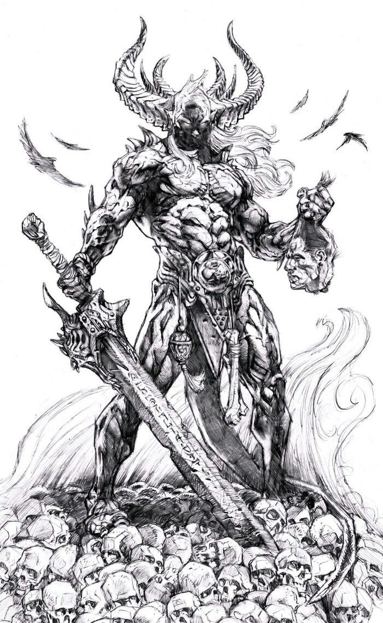
Recent Matches
W: 20 / L: 3
W: 11 / L: 10
W: 8 / L: 13
W: 15 / L: 0
W: 30 / L: 14
Statistics
History

Slide 9
Friends
ABCDEF
Last Played: 03/03/2000
View Profile
Delete Friend
Friends
ABCDEF
Last Played: 03/03/2000
View Profile
Delete Friend
Requests
ABCDEF
Last Played: 03/03/2000
Pending
View Profile
Delete Friend
Search
ABCDEF
Last Played: 03/03/2000
View Profile
Delete Friend

Slide 10
Friends
ABCDEF
Last Played: 03/03/2000
View Profile
Delete Friend
Friends
Are you sure you want to delete this Friend?
ABCDEF
Last Played: 03/03/2000
View Profile
Delete Friend
Requests
Yes
No
ABCDEF
Last Played: 03/03/2000
Pending
View Profile
Delete Friend
Search
ABCDEF
Last Played: 03/03/2000
View Profile
Delete Friend

Slide 11
Requests
ABCDEF
Last Played: 03/03/2000
Accept Request
Decline Request
Friends
ABCDEF
Last Played: 03/03/2000
Accept Request
Decline Request
Requests
ABCDEF
Last Played: 03/03/2000
Pending
Accept Request
Decline Request
Search
ABCDEF
Last Played: 03/03/2000
Accept Request
Decline Request

Slide 12
Requests
ABCDEF
Last Played: 03/03/2000
Accept Request
Decline Request
Friends
Accept this Friend Request?
ABCDEF
Last Played: 03/03/2000
Accept Request
Decline Request
Requests
Yes
No
ABCDEF
Last Played: 03/03/2000
Pending
Accept Request
Decline Request
Search
ABCDEF
Last Played: 03/03/2000
Accept Request
Decline Request

Slide 13
Requests
ABCDEF
Last Played: 03/03/2000
Accept Request
Decline Request
Friends
Decline this Friend Request?
ABCDEF
Last Played: 03/03/2000
Accept Request
Decline Request
Requests
Yes
No
ABCDEF
Last Played: 03/03/2000
Pending
Accept Request
Decline Request
Search
ABCDEF
Last Played: 03/03/2000
Accept Request
Decline Request

Slide 14
Pending
ABCDEF
Last Played: 03/03/2000
View Profile
Cancel Request
Friends
ABCDEF
Last Played: 03/03/2000
View Profile
Cancel Request
Requests
ABCDEF
Last Played: 03/03/2000
Pending
View Profile
Cancel Request
Search
ABCDEF
Last Played: 03/03/2000
View Profile
Cancel Request

Slide 15
Pending
ABCDEF
Last Played: 03/03/2000
Accept Request
Decline Request
Friends
Cancel this Friend Request?
ABCDEF
Last Played: 03/03/2000
Accept Request
Decline Request
Requests
Yes
No
ABCDEF
Last Played: 03/03/2000
Pending
Accept Request
Decline Request
Search
ABCDEF
Last Played: 03/03/2000
Accept Request
Decline Request

Slide 16
Search
ABCDEF
Last Played: 03/03/2000
View Profile
Add Friend
Friends
ABCDEF
Last Played: 03/03/2000
View Profile
Add Friend
Requests
ABCDEF
Last Played: 03/03/2000
Pending
View Profile
Add Friend
Search
ABCDEF
Last Played: 03/03/2000
View Profile
Add Friend

Slide 17
Search
ABCDEF
Last Played: 03/03/2000
View Profile
Add Friend
Friends
Add this Friend?
ABCDEF
Last Played: 03/03/2000
View Profile
Add Friend
Requests
Yes
No
ABCDEF
Last Played: 03/03/2000
Pending
View Profile
Add Friend
Search
ABCDEF
Last Played: 03/03/2000
View Profile
Add Friend

Slide 18
Most Used Heroes
Statistics
Total Games : 170
Wins : 84
Losses : 86
In-game duration : 33h 41m
Heroes Own : 11 / 36
Kills : 200
Deaths : 88
Assists : 124
Statistics
History

Slide 19
Recent Matches
W: 20 / L: 3
W: 11 / L: 10
W: 8 / L: 13
W: 15 / L: 0
W: 30 / L: 14
Statistics
History

Slide 20

Legion A
Level 20 / Member: X
Info
Create / Join Legion
Ranks
Quit Legion
Emblem Earned: 999999
ABCDEF
Affinition: X
View Profile
Remove Member
123456
ABCDEF
Affinition: X
View Profile
Remove Member
123456
ABCDEF
Affinition: X
View Profile
Remove Member
123456

Slide 21
Legion A
Level 20 / Member: X
Info
Create / Join Legion
Ranks
Quit Legion
Emblem Earned: 999999
ABCDEF
Affinition: X
Are you sure you want to quit the Legion?
123456
View Profile
Remove Member
Yes
No
ABCDEF
Affinition: X
View Profile
Remove Member
123456
ABCDEF
Affinition: X
View Profile
Remove Member
123456

Slide 22
Legion A
Level 20 / Member: X
Info
Create / Join Legion
Ranks
Quit Legion
Emblem Earned: 999999
ABCDEF
Affinition: X
Are you sure you want to remove this member?
123456
View Profile
Remove Member
Yes
No
ABCDEF
Affinition: X
View Profile
Remove Member
123456
ABCDEF
Affinition: X
View Profile
Remove Member
123456

Slide 23
Legion A
Level 20 / Member: X
Info
Create / Join Legion
Ranks
Quit Legion
Emblem Earned: 999999
Legion Founder: ABCDEF
Legion Founded: XX/XX/XXXX
Legion Rank: XXX
Legion Description:
-Insert Description Here-

Slide 24
Legion A
Level 20 / Member: X
Info
Create / Join Legion
Ranks
Quit Legion
Emblem Earned: 999999
Legion Founder: ABCDEF
Legion Founded: XX/XX/XXXX
Legion Rank: XXX
Legion Description:
Please type here…
-Insert Description Here-

Slide 25
Find Legion
Legion Name
Member: XXX
Request to Join
Legion Profile
123456
Legion Name
Member: XXX
Request to Join
Legion Profile
123456
Legion Name
Member: XXX
Request to Join
Legion Profile
123456
Legion Name
Member: XXX
Request to Join
Legion Profile
123456

Slide 26
Find Legion
Legion Name
Member: XXX
Request to Join
Legion Profile
123456
Send request to join this Legion?
Legion Name
Member: XXX
Request to Join
Legion Profile
123456
Yes
No
Legion Name
Member: XXX
Request to Join
Legion Profile
123456
Legion Name
Member: XXX
Request to Join
Legion Profile
123456

Slide 27
Legion Ranks
Legion Current Rank: 123456
Legion Name / Level: XXX
Member: XXX
Rank: 1
123456
Legion Name / Level: XXX
Member: XXX
Rank: 2
123456
Legion Name / Level: XXX
Member: XXX
Rank: 3
123456
Legion Name / Level: XXX
Member: XXX
Rank: 4
123456

Slide 28
Quests
Daily
Weekly
Monthly
Daily Quests
Quest #1
Quest #2
Quest #3

Slide 29




Hero List
Hero Name
Hero Name
Hero Name
Hero Name
Hero Name
Hero Name
Hero Name
Hero Name
Hero Name
Hero Name

Slide 30
Hero Backstory
Hero Name
Skin Selection
Skin #1
Skill #1
Skill #2
Skill #3
Skill #4
Skin #2
Skill Name
Skin #3
Skill Description
Skin #4
Hero Stats

Slide 31
Achievements
Achievement #1 Level 1 / Level 2 / Level 3 / Level 4
Achievement #2 Level 1 / Level 2 / Level 3 / Level 4
Achievement #3 Level 1 / Level 2 / Level 3 / Level 4
Achievement #4 Level 1 / Level 2 / Level 3 / Level 4

Slide 32
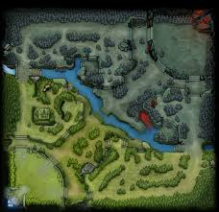
5v5
3v3
Practice
Game Mode
Ranked
Casual

Slide 33
Time Remaining
00:00
Friend Name
Friend Name
Friend Name
Friend Name
Friend Name
All
Hero Name
Hero Description
Damage
Tank
Select Hero
Mage
Support
Ranged

Slide 35
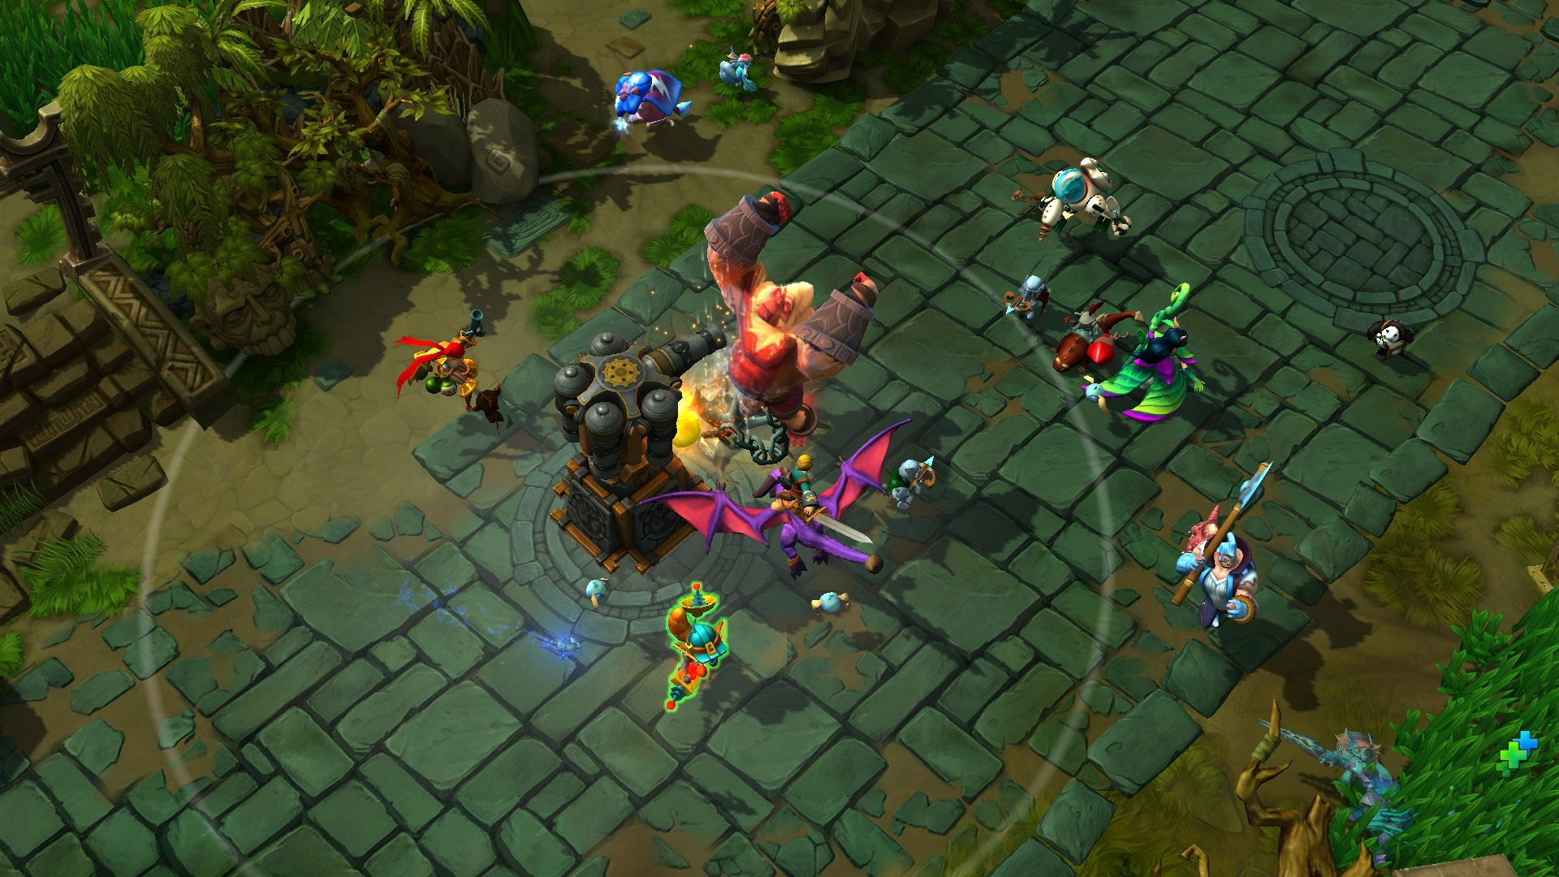




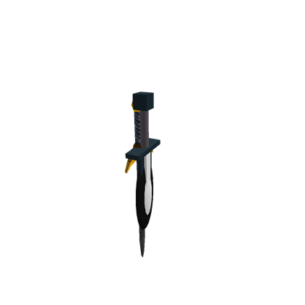

$$$ / Shop
Skill
Skill
Skill
Set Skill
Set Skill
Set Skill

Slide 36
In-Game Shop
Item
Price
Item
Price
Item
Price
Item
Price
Item
Price
Item
Price
Item
Price
Item
Price
Item
Price
Item
Price

Slide 37








Settings
Voice: Enabled
Vibrate: Enabled
zzz
Damage Text: Enabled
Shadow: Enabled
Notifications: Enabled
Language: English
Screen Quality
Low
Medium
High

Slide 38
Game Result
Team A vs. Team B
Player Name/Hero Name
Player Name/Hero Name
Player Name/Hero Name
Player Name/Hero Name
Player Name/Hero Name
Player Name/Hero Name
Player Name/Hero Name
Player Name/Hero Name
Player Name/Hero Name
Player Name/Hero Name

Slide 39




Shop
All
Damage
Tank
Mage
Support
Ranged
Hero
Skin
Special

Slide 40
Settings
Voice: Enabled
Vibrate: Enabled
zzz
Damage Text: Enabled
Shadow: Enabled
Notifications: Enabled
Language: English
Screen Quality
Low
Medium
High

